Slide 1
S-100 Validation Tests sub group
2nd VTC Meeting
6th July 2023

Slide 2
Meeting protocol
Meeting participants are kindly requested to note the following meeting protocols;
Please keep your camera and microphone turned “off” if you are not talking or presenting
If you want to make an intervention, please turn your camera and microphone on and, raise your hand to indicate that you wish to speak
Don’t forget to turn your microphone “on” before speaking, and “off” when finished
Please use the “Chat” function to communicate an text information to the meeting
If you have any problems connecting using Firefox or other browser – please try using Chrome.

Slide 3
AGENDA
Feedback on HSSC & S-101 PT meeting
Summary of HSSC decisions that affect group (June 2023)
Summary of side meeting at S-101 PT (June 2023)
Review of feedback on IIC Validation Tests
Discussion on initial review of S-101 proposed level tests
Initial tests Part1, Part 2, Part 4b, Part 6, Part 17
Discussion on Issues raised
Issue 6
Status on tasks
Next meetings

Slide 4
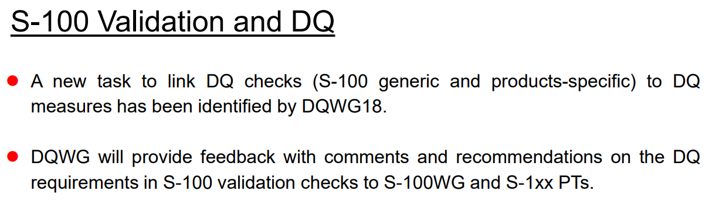
HSSC15 Update – Helsinki, June 2023
S-158 – this has been provisionally held, but not allocated
Not yet determined what is the holding place for S-100 Validation tests
DQWG – there was a question over one the DQWG tasks
ENC WG offered to provide support from S-58 sub WG and collaboration
Potentially hold side meeting/early morning meeting at ENC WG/S-101 PT

Slide 5
Informal session at S-101 PT10, Brest – June 2023
Reviewed IIC posted checks (next slide)
Proposed hierarchy of test
Product Specification Tests
S-100 Validation Tests
Interoperability Tests
Suggestion to have a cross check across Product Spec Validation tests
Is this something we want to proceed with?
If yes – when? Potentially start after S-100WG 9
Dependent on being provided access to Validation Tests
Recommendation to involve Inland ENCs – contacted Chair and asked for them to participate in session on Validation S-100 WG9 meeting.
SCOPE:
1st phase - Dataset and catalogue
2nd phase – Service levels, S-128
3rd phase – data of multiple types - or is this S-98?

Slide 6
Feedback on initial iic tests
Too specific
ECDIS focused
Some of the tests were potentially Prod Spec level tests
Need to think about purpose of the test
Format specific tests – consensus seems to be not to include at S-100 level but then are Prod Specs aware they need to cover them?

Slide 7
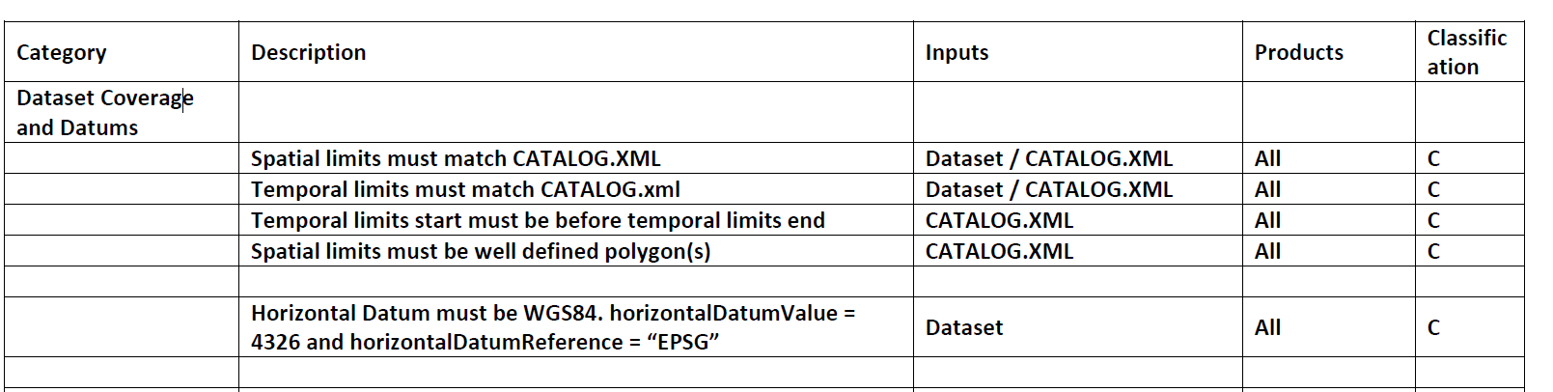
Dataset coverage and Datums
Question over whether the inputs section was sufficient
Do we need to add Errors to the Classification? - just C & W now
Temporal limits, where is that covered at the moment?
Horizontal datum must be stated in the PS, is this too specific for S-100 level?

Slide 8
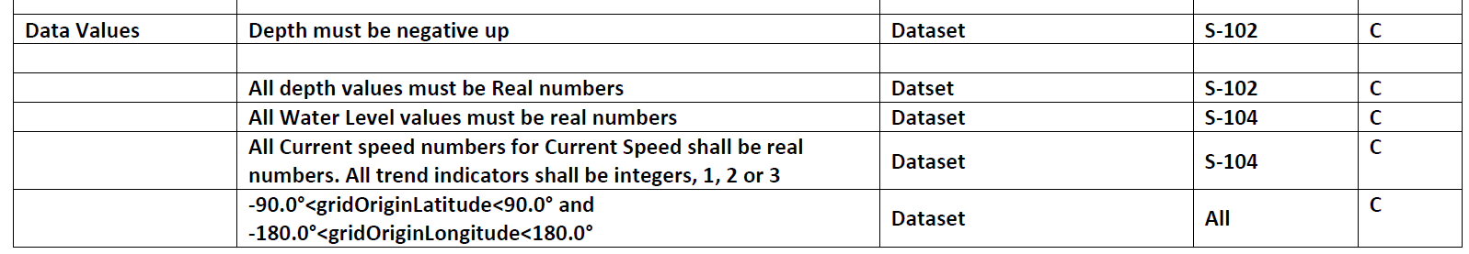
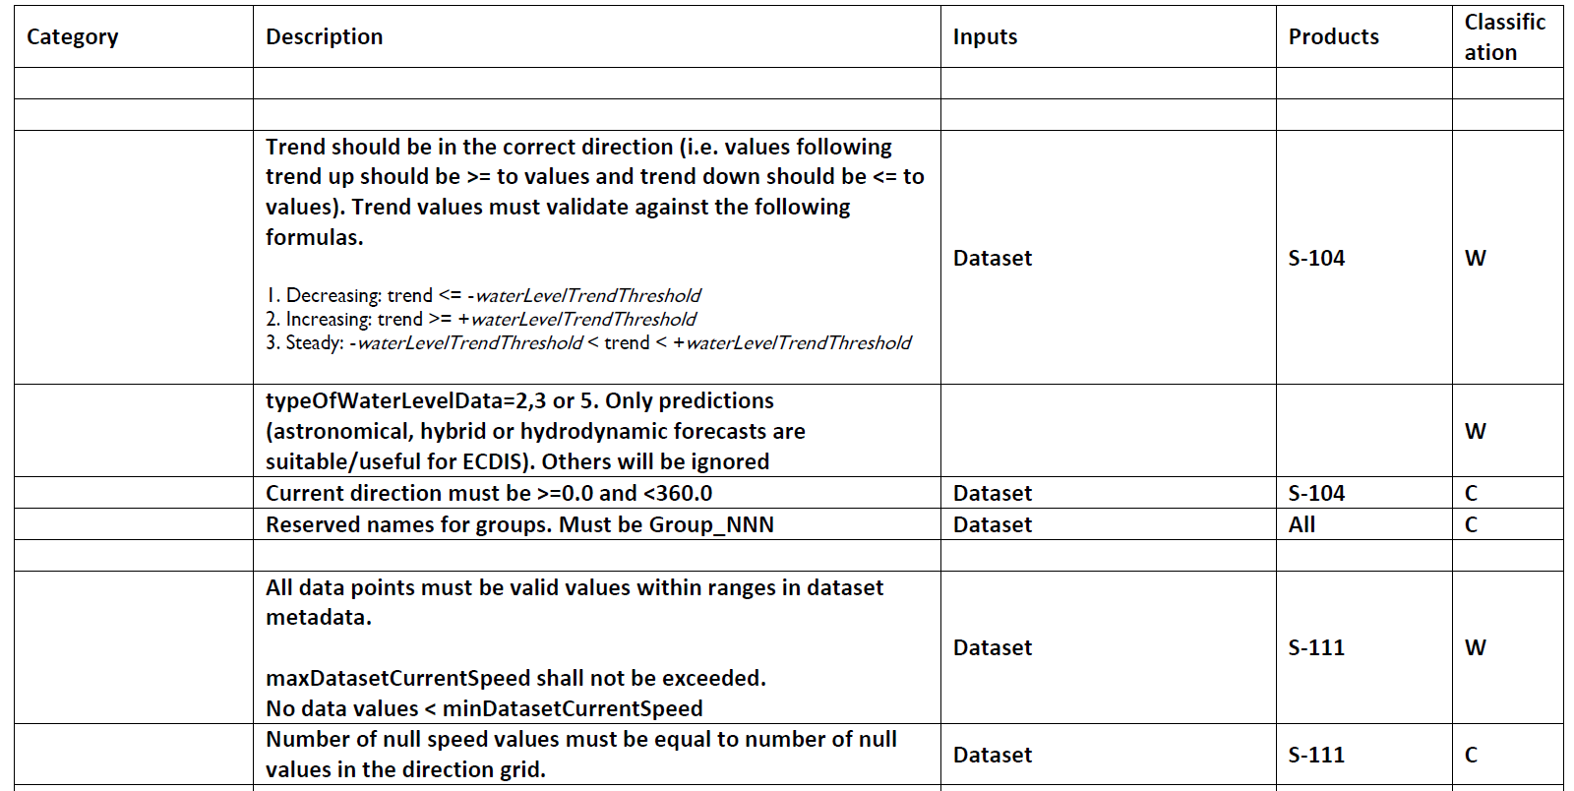
Data values
Too specific, need to be more generic
Depth values – real numbers
Attribute values must conform to feature type and catalogue
- perhaps have check cell attribute conforms? (Frank)
Anything to do with FC and bindings to relationship types. Analysis software can check against FC and binding is valid.
Need to involve Inland ENCs?
Where have a numeric range can be specified in FC no S-100
Reserved names – Group NNN – HDF5, should this be for all rasters or just… (S-102?)

Slide 9
Coverage
Dataset checks and corresponding check and service level checks – will need S-128

Slide 10
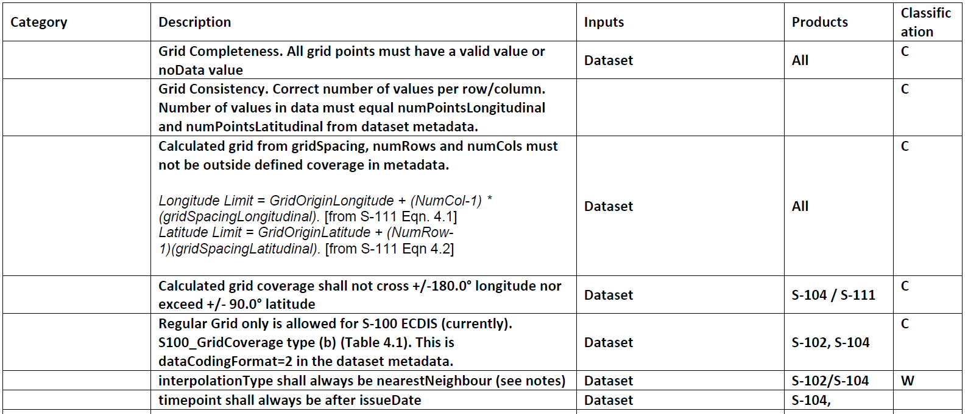
Grid structure
Is this HDF5 encoding?
Questions about whether format specific checks should be a this level – if not here where?
Is interpolation constrained in the PS?
Timepoint was questioned

Slide 11
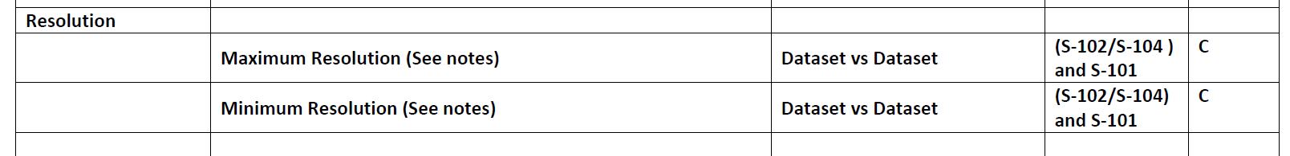
Resolution

Slide 12
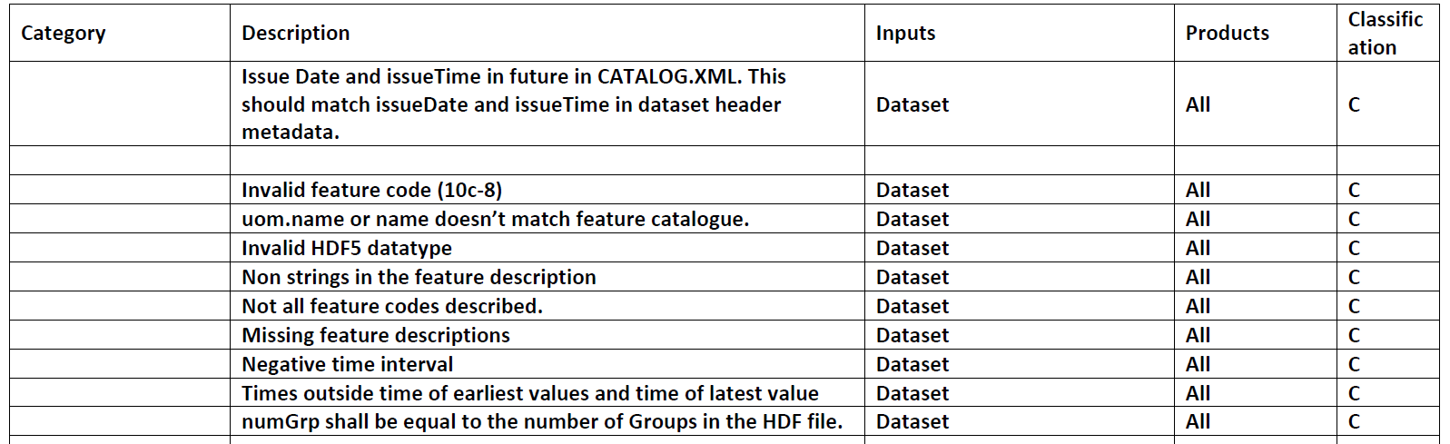
Dataset Metadata
Metadata – both encoding and XC to this slide

Slide 13
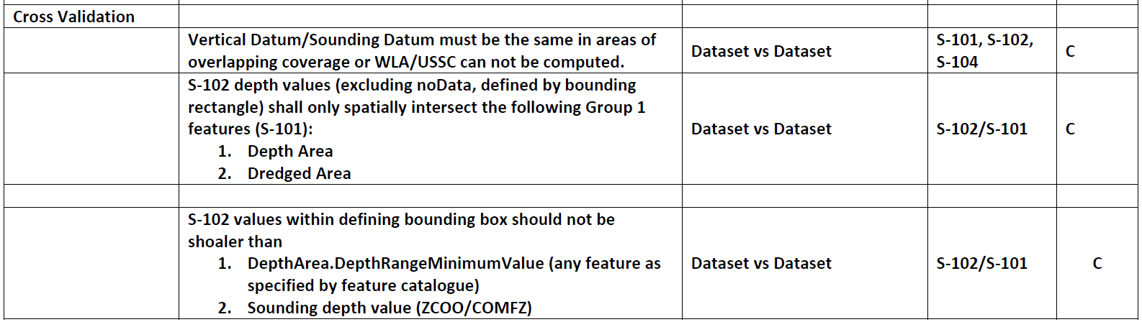
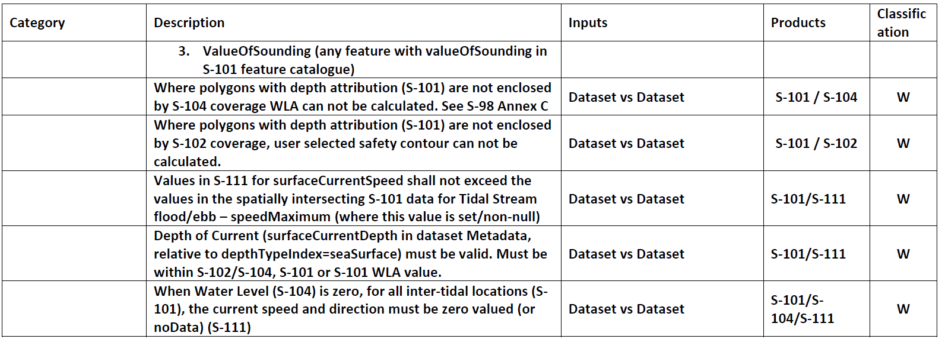
Cross validation
Dataset vs dataset could this be ‘within’?
Think about purpose of tests
Focus on S-58 – not sure if this was focus more or focus less!
S-102 shall only dissect node
Expect differences between products schema – is this a more general comment?
Remove Warning at this stage?
Is this last check correct?

Slide 14
Proposed way forward
Produce a set of tests from Parts of S-100 & Proposed S-101 generic S-100 tests
Tabulate and place on GitHub
Then group to comment and raise issues using Check ID in title
65 tests written from Part1, Part 2, Part 4b, Part 6, Part 17
Are these tests being produced from the perspective of ECDIS use or more generic than that?
Or split into ECDIS/ Non-ECDIS?

Slide 15
Review of S-100 Parts
Do we list every mandatory requirement in the S-100 UML models?
What about every situation that is not mandatory but if it is captured there can be only one? [0..1]
Need assistance in collating and reviewing tests
Naming convention proposal – have implemented in draft but may change

Slide 16
Initial review of proposed tests from s-101PT
DK has conducted an initial review
Need to determine where is the boundary between Prod Spec and S-100 level tests
Will likely need to cover in Introduction document at beginning of tests
Next slide has tests for discussion
Tests my need lifting up to S-100 level as are based on S-58 tests and are ENC focused

Slide 17
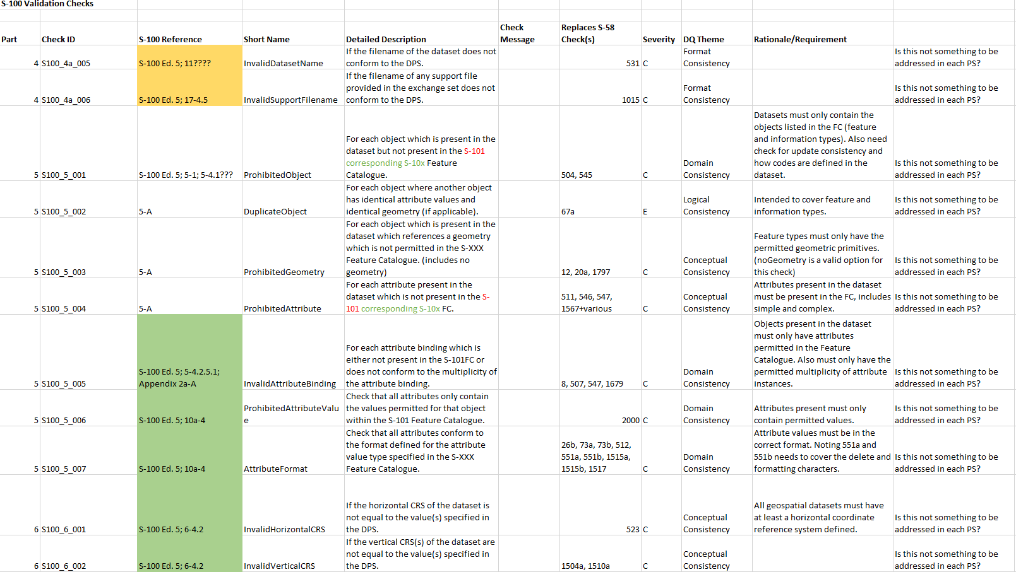

Slide 18
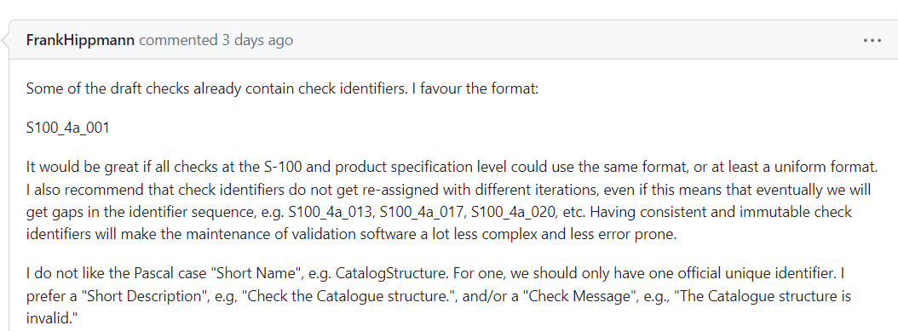
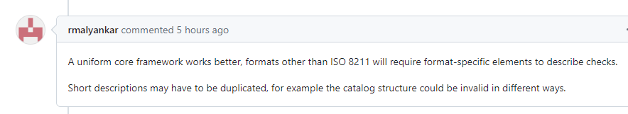
Naming convention of tests
Issue 6 on GitHub https://github.com/iho-ohi/S-100-Validation-Checks/issues/6

Slide 19
Deliverable – Nov 2023
Initial list of high level checks
Can be expanded upon afterwards
Document write up with an initial explanation of ‘what is S-100 level validation’

Slide 20
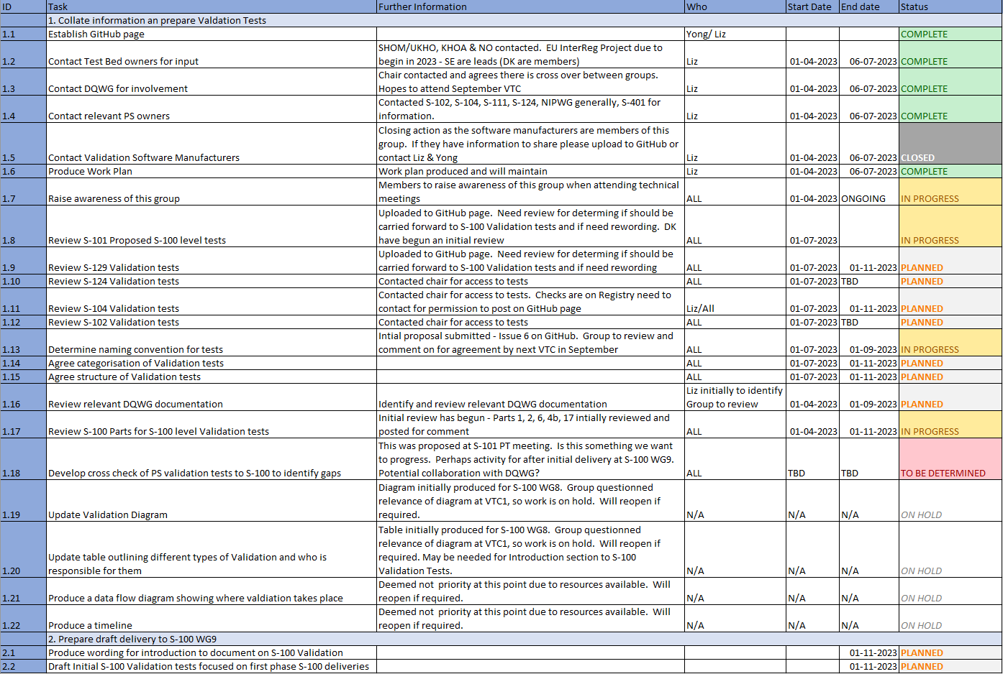
Work plan

Slide 21
Next steps
Review Issue 6 and comment ahead of next VTC in GitHub. Want to agree naming convention at that meeting.
Continue to review S-100 Parts
Volunteers to write tests?
Review new S-100 validation tests that are posted – if have comments, create an issue with the Check ID in the Issue name.
Not just content, also categorization and structure of tests
When raise an Issue need to be clear on what is needed to close it
Review posted PS Validation tests – S-101 & S-129
(be aware ‘S-101 proposed S-100 Validation tests’ & ‘S-100 Validation Tests’ are using same naming convention)
Identify and post links to DQWG relevant documents for review
https://github.com/iho-ohi

Slide 22
Next meetings
Early September VTC
Thursday 7th September is proposed date, to avoid clash with NIPWG.
Proposed new time slots (19 in Europe, 3 in Australia, 3 east coast US, 5/6 west coast US)
15:00 – 17:00 (CEST) – 6:00 California, 9:00 Washington, 21:00 Beijing, 23:00 Sydney
19:00 – 21:00 (CEST) – 10:00 California, 13:00 Washington, 01:00 Beijing, 03:00 Sydney
End September ENC WG/S-101PT WG meeting - Lombok, Indonesia 25-
Hold side meeting/early morning meeting
November S-100 WG 8 meeting – Singapore 13-17th November
Do we want to hold a VTC meeting prior to that meeting? In the first week of November or end of October?

Slide 23
Any Questions?

Slide 24
Initial review of proposed tests from s-101PT
Invalid Dataset Names
The filename of the dataset does not conform to the DPS
The filename of the support file does not conform to the DPS
Prohibited Object/Geometry/Attribute
For each object that is present in the dataset but not present in the FC
For each object that is present in the dataset which references geometry which is not permitted in the FC (includes no geometry)
For each attribute that is present in the dataset which is not present in the FC
All attributes only contain the values permitted for that object within the FC

Slide 25
Initial review of proposed tests from s-101PT
Duplicate Object
For each object where another object has identical attribute values and identical geometry
Invalid Attribute Binding
For each attribute binding which is either not present in the FC or does not conform to the multiplicity of the attribute binding
Attribute Format
All attributes conform to the format defined for the attribute value type specified in the FC
Invalid Horizontal/Vertical CRS
If the horizontal/vertical CRS of the dataset is not equal to the value specified in the DPS

Slide 26
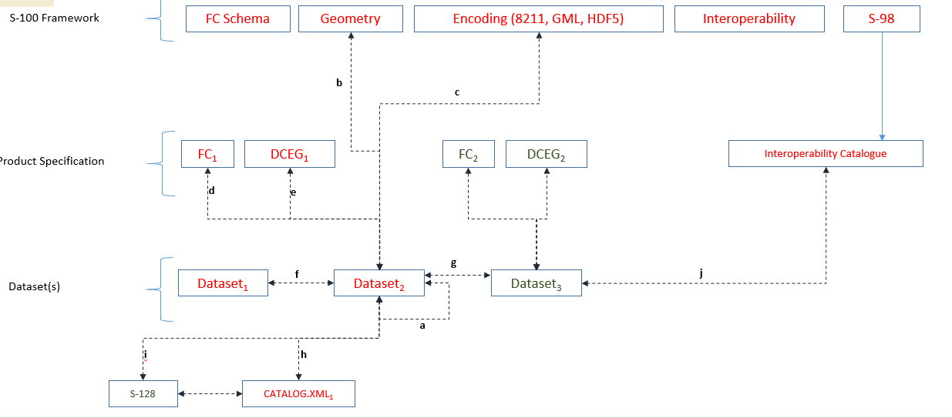
BackgrouND – S-100 WG7 Workshop
Missing:
Portrayal Catalogue
Validation between different versions of Product Specifications

Slide 27
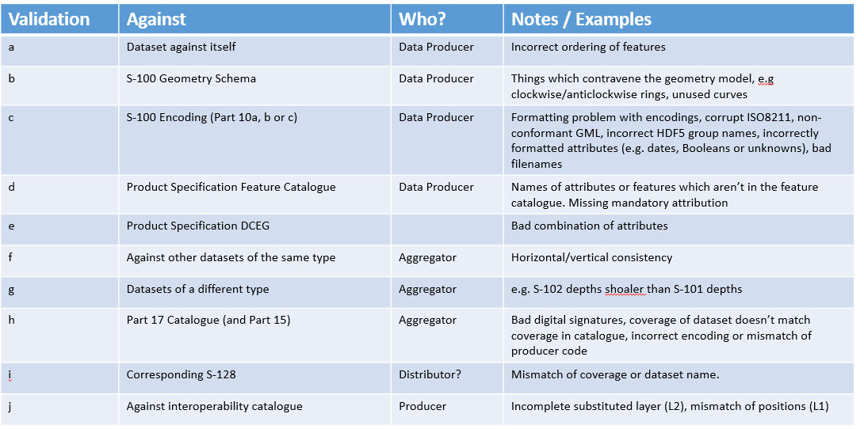
BackgrouND – S-100 WG7 Workshop
Responsibilities:
Who writes & maintains the different types of validation
Aggregator = RENC/VAR/Distributor. Potentially change to Service Provider

Slide 28
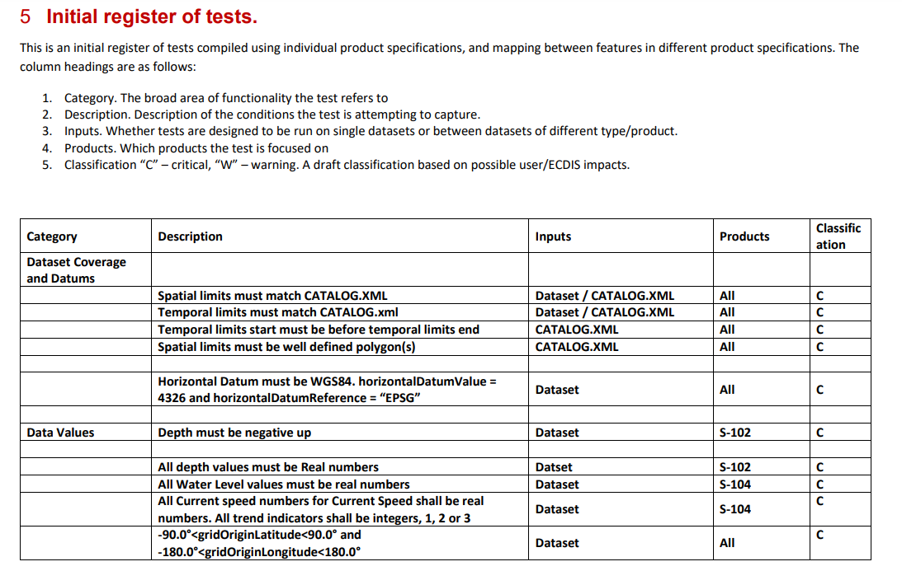
Proposed structure for tests
Propose adding Standard/document to refer to
Categories:
Dataset Coverage and Datums
Data Values
Coverage
Grid Structure
Resolution
Dataset Metadata
Cross Validation

Slide 29
Product
Specifications
S-164
S-98 & Interoperability
S-100 Validation

